Slide 1

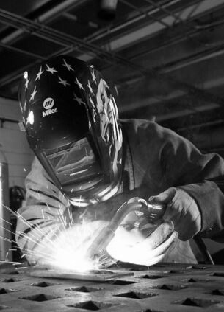


Boschma Farm
Shared Vision

Slide 2

Overview
THE TASK: Finalize and implement the holistic plan for campus expansion at Boschma Farms
11
  Task Force Members
22
  Stakeholder Meetings
5
  Visioning Workshops
1
  Vision
Notes:
Instruction
Economic + Community Development
Student Affairs
Administration
Facilities
Information Technology
Clark College Foundation

Slide 3


INSTRUCTION
ECONOMIC & COMMUNITY DEVELOPMENT
FOUNDATION
  Student pathway to family living wage jobs with progressive opportunities
  Stackable certifications with multiple entry and exit points
  Cross-disciplinary programs with both traditional and customizable training
  Earn and learn
  Guaranteed job interviews
  Students will be able to access their required courses and holistic supports without needing to leave BF
  26,000 sq ft center with computer labs, workspaces, community / business gathering / project space and shop floor with manufacturing equipment
  Short term training (digital focus)
  Entrepreneurial, innovative, agile and market focused
  Heart of the Discovery Corridor
  Commercial / retail services to students + community
  Community destination
  Industry partner
Three complimenting visions

Slide 4
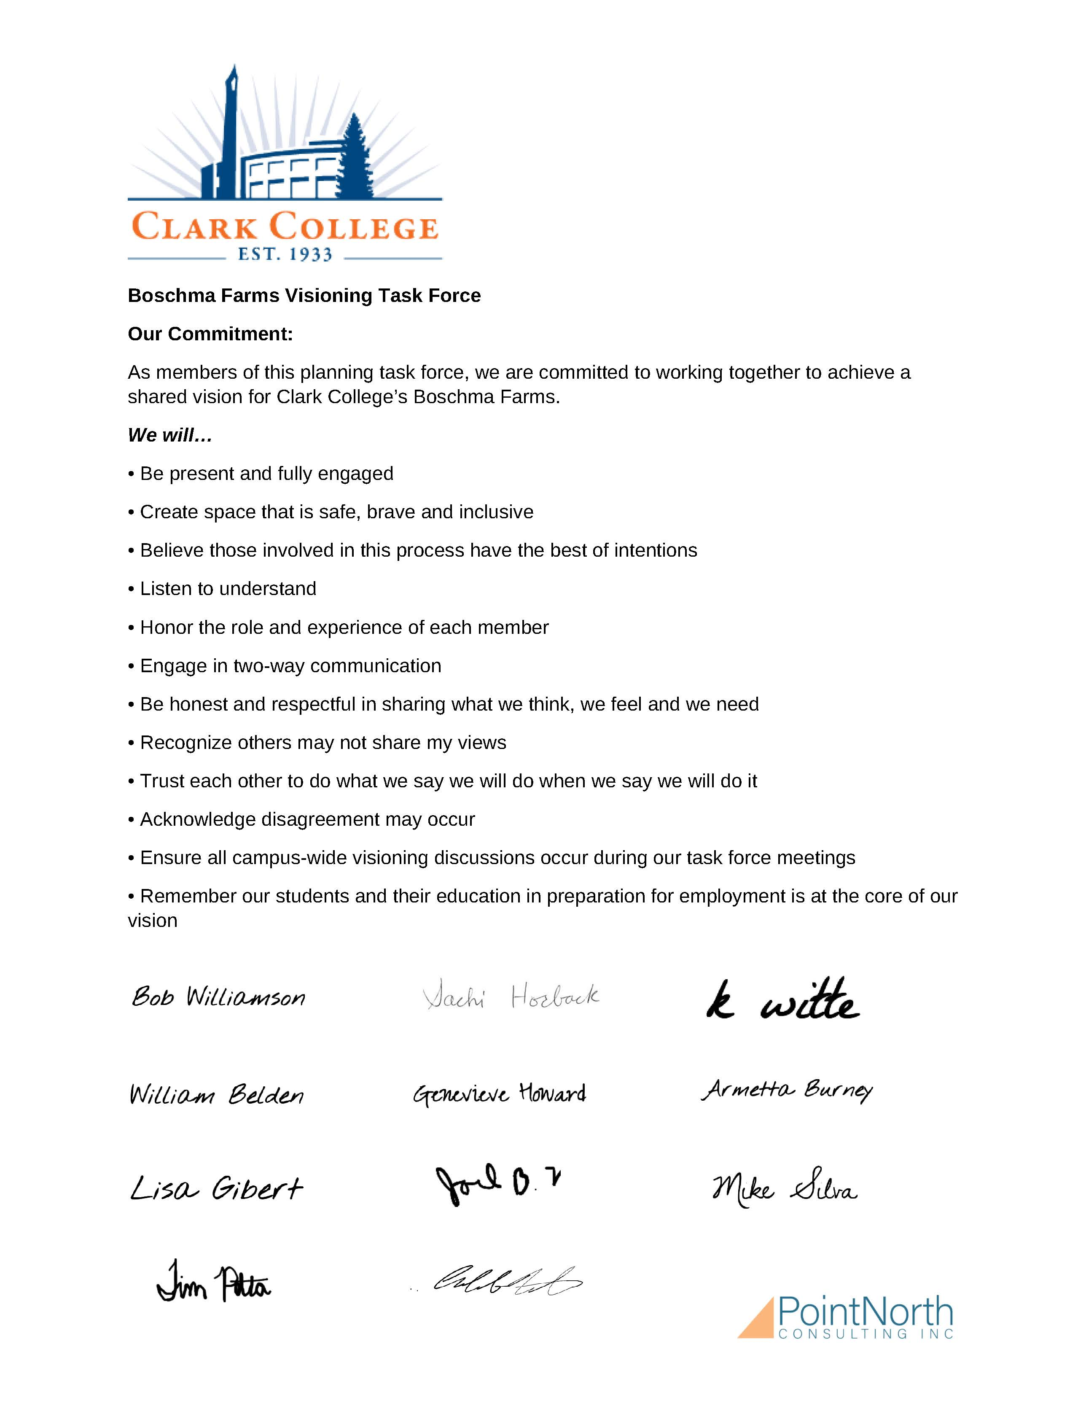
Our commitment

Slide 5
We tested numerous assumptions by asking questions:
  Is Advanced Manufacturing the right focus?
  What do we mean when we say this campus will be focused on “advanced manufacturing”?
  How will we differentiate our program from other regional programs?
  How many students can / will we serve?
  What will the student experience be attending class on this campus?
  What will be the impact for students be to attend Advanced Manufacturing classes on three campuses?
  How will guided pathways be reflected in the student experience?
  How do accommodate general education classes?
  What is a compelling value proposition to recruit students to this program + campus?
Assumptions tested

Slide 6
  What programs / courses will we offer?
  Will there be a duplication of course offerings taught by Clark College Faculty versus Economic + Community Development instructors?
  What are the staffing needs to realize our vision? New hires?
  How many buildings are necessary to realize our vision?
  How do we design a building to best reflect our student and community needs today and tomorrow?
  How much have we already spent on designing the academic building?
  What are the implications for choosing a different design for the academic building?
  When is the earliest date we may anticipate legislative funding for the academic building?
Assumptions tested

Slide 7
  What is the cost of the Workforce Innovation Center? What funding do we have secured for this Center?
  What is our long-term funding strategy for this Center?
  What are the true equipment costs for the Workforce Innovation Center and the Academic Building?
  What funding capacity exists for the equipment budget?
  What are the threats and / or risks to this vision?
  What is the impact of COVID on our vision?
Assumptions tested

Slide 8
Boschma Farm Vision
ADVANCED MANUFACTURING + GENERAL EDUCATION
Clark College's Boschma Farm campus will be a thriving, entrepreneurial center for students, industry, and community partners to advance innovation through technology and learning.
  Students will have pathways to family wage jobs with progressive opportunities
  Integrated and cross-disciplinary programs will meet industry and community needs today while being agile and responsive to future needs

Slide 9
Boschma Farm Vision
ADVANCED MANUFACTURING + GENERAL EDUCATION
  Integrated and cross-disciplinary programs will meet industry and community needs today while being agile and responsive to future needs
  Commercial and retail services will support student and industry needs and attract the community to gather
  We will accomplish this vision by co-locating Instruction and Economic + Community Development in one, state-funded building. The focus will remain on Advanced Manufacturing and both credit and non-credit courses will be offered.
  We will not advance a Workforce Center at this time.

Slide 10
Hire a Boschma Farm Vision Leader
Develop a comprehensive and coordinated stakeholder outreach plan
Create a robust marketing plan to excite students and attract industry
Workforce Innovation Center
Recommendations

